Slide 1
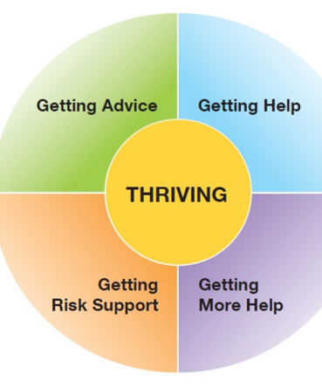
Wigan THRIVE Directory:
Mental Health Services for Children & Young People
Contact Marie Baron for any changes or additions: marie.baron@wiganboroughccg.nhs.uk

Slide 2
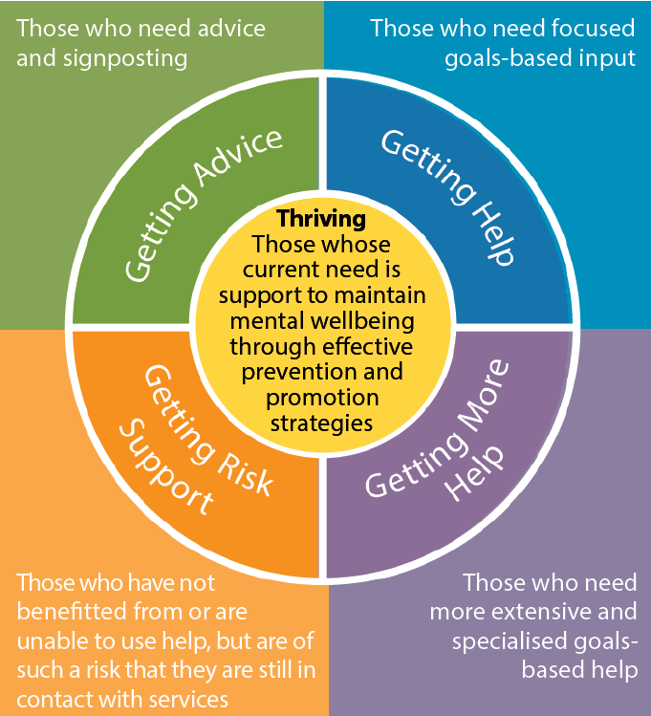
THRIVE Directory: Children & Young People
Mental Health Services
The THRIVE Framework is an integrated, person centred and needs led approach delivering mental health services for children, young people and their families. THRIVE includes five quadrants;
Thriving, Getting Advice and Signposting, Getting Help, Getting More Help and Getting Risk Support.
Emphasis is placed on Prevention and also the Promotion of mental health and wellbeing across the whole population. Children, young people and their families are empowered through active involvement in decisions about their care through shared decision making, which is fundamental to the THRIVE approach.
The left side column will show you what mental health support is available in each of the five THRIVE quadrants.

Slide 3
Crisis Mental Health Support: Wigan 0-25yrs
Our crisis lines are free phone numbers and are available in Wigan and are for patients and public of all ages (children, young people and adults) to call when they are experiencing a mental health crisis or are worried about someone else who may be in crisis.
We recognise that professionals including GPs, police, paramedics and others may have someone they're supporting in their professional capacity that may be in crisis and needs urgent mental health support.
In these circumstances, when you need immediate assistance rather than ringing the Freephone crisis line, please either:
contact the team they are currently under the care of (if applicable and known)
contact the relevant local team below for advice, guidance and response where this is needed
For young people 18-25yrs please contact:
Mental Health Crisis line: 0800 051 3253 open 24/7 (all age after 5pm) Mental Health Urgent Response Team | Greater Manchester Mental Health NHS FT (gmmh.nhs.uk)
For children and young people (up to the age of 18), please contact: Wigan CAMHS Team on 01942 775400 open 9-5pm please call 0800 051 3253 after 5pm

Slide 4
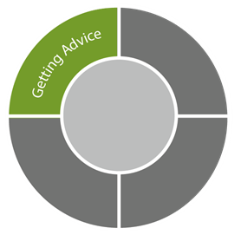
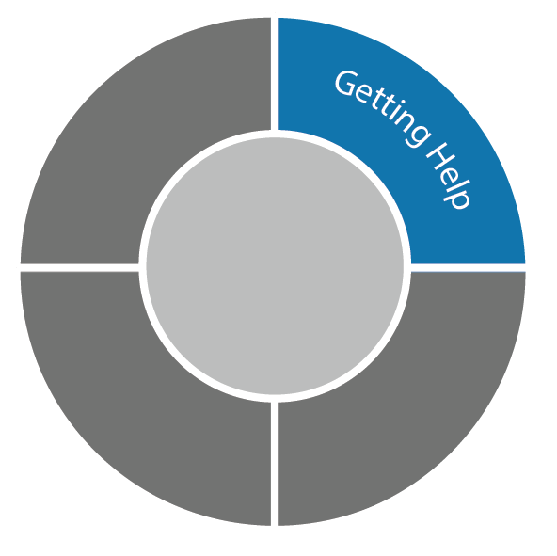
Children & Young People: Online Materials
Young Minds – Charity that offers information about mental health and emotional wellbeing. http://www.youngminds.org.uk/for_children_young_people
ADHD Foundation – children support online - https://www.adhdfoundation.org.uk/childrens/
Beat (national eating disorder charity) - www.b-eat.co.uk Contact: 0345 634 1414
Childline / CALM ZONE – Advice online or on the phone (any time or day) – 0800 1111 https://www.childline.org.uk/toolbox/calm-zone/
HeadMeds – Information medication for mental health difficulties – http://www.headmeds.org.uk/
MIND mental health charity -https://www.mind.org.uk/
Moodjuice – Self-help, information and advice for people experiencing troublesome thoughts, feelings and actions. – https://www.nhsinform.scot/illnesses-and-conditions/mental-health
Anna Freud Mentally Healthy Schools is a free website for children young people and Teachers with lots of information, advice and practical resources to better understand and promote pupils’ mental health and wellbeing. There is access to tools to manage emotions. These tools are designed to help children understand and manage their emotions and feelings, and stay calm and in control in the classroom. Website: https://www.mentallyhealthyschools.org.uk/resources/tools-for-managing-emotions/
The Mix/Get Connected – Advice on the phone for under 25s (1pm -11pm, 7 days a week) 0808 808 4994, http://www.themix.org.uk/ - The Mix is a UK based charity that provides free, confidential support for young people under 25 via online, social and mobile.

Slide 5
Children & Young People: Online Materials : Self Harm
NHS booklets – self help booklets Website: https://web.ntw.nhs.uk/selfhelp/
National Self Harm Network forums – http://www.nshn.co.uk/
NHS choices – http://www.nhs.uk/Conditions/Self-injury/Pages/Treatment.aspx
Samaritans – Advice on the phone (any time or day) – 116 123, http://www.samaritans.org/about-us/our-organisation/read-our-publications/young-peoples-emotional-health-resource
The Mix/Get Connected – Advice on the phone for under 25s (1pm - 11pm, 7 days a week) or online – 0808 808 4994, http://www.themix.org.uk/
YoungMinds Parents Helpline – call 0808 802 5544 (9.30am-4pm on weekdays)
ChildLine – Advice online or on the phone (any time or day) – 0800 1111, https://www.childline.org.uk
Kooth - An online counselling and emotional well-being platform for children and young people in Greater Manchester, accessible through mobile, tablet and desktop with online materials for self help.
https://www.kooth.com/
Silvercloud - SilverCloud offers online programmes for adults (aged 16 years+) to help ease your levels of stress, sleep better or to build resilience - https://hub.gmhsc.org.uk/mental-health/silvercloud/

Slide 6
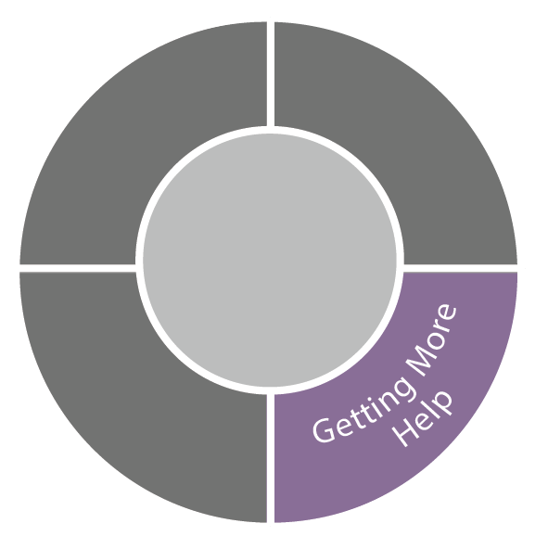
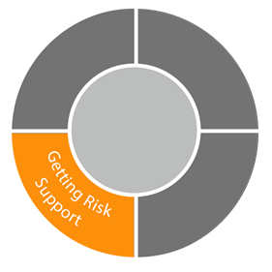
Children & Young People: Online Materials Self-Harm
CALM HARM APP - Calm Harm is based on the principles of dialectical behaviour therapy (DBT). DBT is a type of talking therapy that's often effective in people with mood disorders. Calm Harm is designed for people who are trying to manage urges to self-harm.
The app provides tasks that encourage users to distract themselves from urges to self-harm and help manage their "emotional mind" in a more positive way. Please note that the app is an aid to treatment, but doesn't replace it. The app is free to download from the App Store and Google Play.
BlueIce - is a evidenced-based app to help young people manage their emotions and reduce urges to self-harm. This is only available on ‘prescription’ from a clinician working in child and adolescent mental health services
National Self Harm Network forums – http://www.nshn.co.uk/
Mind – http://www.mind.org.uk/
Harmless – Offers coping strategies, leaflets, and factsheets about self-harm – http://www.harmless.org.uk/
Papyrus Supporting your child with self harm and suicidal thoughts
PAPYRUS Launch New Guide For Parents | Papyrus UK | Suicide Prevention Charity (papyrus-uk.org)
distrACT – Free App which provides information and advice about self-harm
nhs.uk/apps-library/distract

Slide 7
Children & Young People: Online Materials : Bereavement
Papyrus – the national UK charity dedicated to the prevention of young suicide. They have a confidential helpline (0800 068 41 41) or you can email them (pat@papyrus-uk.org) or text them 07786 209697
CALM – the Campaign Against Living Miserably exists to prevent male suicide in the UK. They use young men’s peers, their voices and interests to reach them and their materials and communications are created by young men. You can call or text their helpline – see their site for details depending on your location.
under 18’s support – part of Cruse Bereavement Care, this site is designed by young people for young people and includes an interactive section. If you are a young person you can send a private message to one of their trained volunteers at info@rd4u.org.uk who will reply to you by email. If you want to talk to someone direct, you can call their FREE phone helpline on 0808 808 1677. Cruse also offer support to adults caring for bereaved children or young adults.
Winstons Wish – the leading childhood bereavement charity and the largest provider of services to bereaved families in the UK. They have specialist expertise in supporting children bereaved by suicide and they also have a site for young people.
Grief Encounter– provider of support services for bereaved children and their families throughout the UK in order to help children find ways out of the abyss of grief. Their site has sections for children and young adults.
Samaritans – if you are under 18, you can still talk confidentially to the Samaritans . They won’t tell you what to do, they will listen and try to understand what you’re going through. Their number is 116 123 (UK) or look at their site for other ways to contact them.
Childline – Childline is a private and confidential service for children and young people up to the age of nineteen. You can contact a Childline counsellor about anything – no problem is too big or too small. Call them free on 0800 1111, have a 1-2-1 chat online or send an email.
If U Care Share – If U Care Share Foundation are a charity promoting emotional well being in young people & supporting families affected by suicide.
Child Bereavement UK – supports families and educates professionals when a child dies or is dying or when a child is facing bereavement. Young people can contact them confidentially by phone on 0800 02 888 40 or email them.
Richmond’s Hope supporting Children from the age of 4 to 18 who have suffered a bereavement. Referrals can be made by contacting 0141 230 6123. email glasgow@richmondshope.org.uk

Slide 8
Online Materials: Parents / Carers
Parents and Carers Support – Anna Freud
Advice for parents and carers of primary school pupils | Talking mental health primary school | Anna Freud Centre
Mental Health Foundation
Parents and mental health| Mental Health Foundation
Listen First Parenting under COVID-19 (unodc.org)
Papyrus Supporting your child with self harm and suicidal thoughts
PAPYRUS Launch New Guide For Parents | Papyrus UK | Suicide Prevention Charity (papyrus-uk.org)
MindEd Should I be worried? MindEd For Families
Every Mind Matters – looking after a child or young persons mental health
Children's mental health | Every Mind Matters | One You (www.nhs.uk)
Young Minds -Call the Parents Helpline: 0808 802 5544 (Monday to Friday 9.30am – 4pm, free for mobiles and landlines)
https://youngminds.org.uk/
ADHD Foundation support for parents - https://www.adhdfoundation.org.uk/parents/
Family Meditation training and workshops – www.talkfirst.org

Slide 9
Children & Young People: Telephone and Texting Support
Kooth is an online counselling, advice and mental health support service for young people in Wigan aged 11-19. As we are commissioned by Wigan CCG it is free for young people to use and is self-referral, meaning there is no need to visit a GP to access the service. Completely anonymous, it takes just a few minutes to sign up to the site where young people can then speak to fully qualified counsellors and therapists until 10pm, 365 days per year. There are also forums where young people can get peer based advice; these are all fully moderated by Kooth staff to ensure a safe and supportive environment. All counsellors are BACP accredited and police checked, and will continue to support young people for the duration they need. Young people please visit: www.kooth.com
CALM HARM APP - Calm Harm is based on the principles of dialectical behaviour therapy (DBT). DBT is a type of talking therapy that's often effective in people with mood disorders.
Who is it suitable for? Calm Harm is designed for people who are trying to manage urges to self-harm.
The app provides tasks that encourage users to distract themselves from urges to self-harm and help manage their "emotional mind" in a more positive way. Please note that the app is an aid to treatment, but doesn't replace it. The app is free to download from the App Store and Google Play.
Samaritans operates a free-to-call service 24 hours a day, 365 days a year, if you want to talk to someone in confidence. For emotional support please see our national information. Samaritans provide confidential, non-judgemental support 24 hours a day for people who are experiencing feelings of distress or despair, including those which could lead to suicide. Call us free on 116 123 or email jo@samaritans.org website: https://www.samaritans.org/branches/wigan/
Papyrus HopelineUK for under 35s. If you are having thoughts of suicide or are concerned for a young person who might be you can contact HOPELINEUK for confidential support and practical advice.
Call: 0800 068 4141 open 9am until Midnight including bank holidays
Text: 07860039967
Email: pat@papyrus-uk.org
Website: HOPELINEUK | Papyrus UK | Suicide Prevention Charity (papyrus-uk.org)

Slide 10
EMBRACE – We are a user-led charity dedicated to supporting disabled people and their families. We have a range of projects that aim to enhance the lives of the people we support. 01942 233323 Mon-Thur 9am – 5pm Website: https://www.embracewiganandleigh.org.uk/about-us/
Gambling Support – Youth Outreach Programme and online support / Resources - 0151 226 0696 https://beaconcounsellingtrust.co.uk/youth-outreach-programme/
Beat (national eating disorder charity) - www.b-eat.co.uk Contact: 0345 634 1414
Childline / CALM ZONE – Advice online or on the phone (any time or day) – 0800 11 11 https://www.childline.org.uk/toolbox/calm-zone/
The Mix Get Connected - Provides advice on the phone for under 25s (1pm - 11pm, 7 days a week) or online 0808 808 4994, http://www.themix.org.uk/
Shout 85258 - is a free, confidential, anonymous text support service. You can text from wherever you are in the UK. you're struggling with anxiety, depression, suicidal thoughts, abuse or assault, self-harm, bullying or relationship issueshttps://giveusashout.org/get-help/
BlueIce - is a evidenced-based app to help young people manage their emotions and reduce urges to self-harm. This is only available on ‘prescription’ from a clinician working in child and adolescent mental health services
Anxiety UK – This is a user-led organisation, with resources, text service and info line.: 03444 775 774 Website: www.anxietyuk.org.uk
Sexual Assault and Rape Counselling - https://www.stmaryscentre.org
Domestic Violence and abusive relationships – specialist counselling in schools 01942 311365 support@diasdvc.org
Young Carers – email info@walyc.org.uk

Slide 11
Children & Young People: Community Activities
Groundwork is a local charity that helps change places and lives for thousands of people.
They have an excellent track record of supporting young people and adults to make life changing decisions to improve their life skills, employment opportunities and create better outcomes for the people they support.
They are currently looking to engage with enthusiastic young people aged 16-18 who want to make a difference in their local community by participating in a bespoke Traineeship programme. The Traineeship Programme gives individuals the chance to gain skills, knowledge and experience that is needed to get an apprenticeship or job in a chosen career field. The programme will provide a meaningful work placement at an established local company, relevant to the career field the individual is interested in.
What’s in it for the young person?
Gain skills, knowledge and experience in a chosen career field
Travel costs, bursaries and incentives are funded by Groundwork and college providers
1:1 weekly mentor support is provided
Improve your mental health and wellbeing
Improve life skills and make new friends
Make a difference in their local community
If you are interested, please contact Laura Swindell
Email: Laura.Swindell@groundwork.org.uk
Contact: 07715629928

Slide 12
Children & Young People: Community Activities
Wigan Youth Zone - At Wigan Youth Zone, they aim to provide the best possible experience and outcomes for young people in a fun, supportive, safe, inclusive and positive environment. Wigan Youth Zone is a purpose built, state-of-the-art youth facility in Wigan town centre which opened in June 2013. It offers young people from across Wigan the opportunity to meet friends, have new experiences, learn new skills and access the support they need to develop and achieve their potential.
The Youth Zone is open to all young people across Wigan aged from 8 to 19, striving to offer something for everyone, regardless of their interests or abilities. With almost 15 dedicated areas to choose from including our four 40-metre floodlit football pitches, art room, music room and climbing wall – there’s something for everyone here at Wigan Youth Zone. Website: https://www.wiganyouthzone.org/young-people/ Contact: Sikander Ali – Youth Work Manager tel: 01942 612061 sikander.ali@wiganyouthzone.org
Children's community CAFÉ - Coming soon!– Based at Leigh college
Each year the Prince’s Trust Team Programme helps thousands of young people to get their lives back on track. Getting involved with the Prince’s Trust Team Programme will help young people to build motivation, confidence and allow them to develop new skills whilst gaining qualifications, work experience and improving their futures.
Princes Trust Contact details fiona.winstanley@groundwork.org.uk 07713565442/ 07740546152 Prince’s Trust Team Programme | Groundwork
Get Fit for Free - The secret to getting fit for free is to use every opportunity to be active
https://www.nhs.uk/live-well/exercise/free-fitness-ideas/

Slide 13
Think Wellbeing : Psychological Therapies
Think Wellbeing offers free NHS therapy for people registered with a Wigan GP with common mental health problems like anxiety or depression, to help you change the way you feel by changing the way you think.
Who is our service for?
Our service is for young people age 16+ with common mental health problems like mild to moderate depression, anxiety and stress. We can help with other problems like panic attacks, phobias and post traumatic stress disorder.
We are also able to help if you're experiencing symptoms of low mood, anxiety or depression linked to a long term physical health condition, pregnancy or being a primary carer for an infant under the age of two.
Self refer: Tel: 01942 264 051
https://www.nwbh.nhs.uk/think-wellbeing-wigan
You must be registered with a Wigan GP to access our service.
Think Wellbeing Silvercloud - is a online programme for young people (aged 16 years+) to help ease your levels of stress, sleep better or to build resilience
https://hub.gmhsc.org.uk/mental-health/silvercloud/

Slide 14
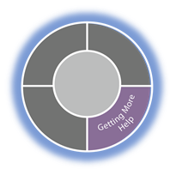
GMMH CAMHS: Wigan
Our Child and Adolescent Mental Health Services - also known as CAMHS - work with young people with emotional, behavioural or mental health difficulties, and their families.
Our service is for children and young people up to the age of 18 who have emotional, behavioural or mental health difficulties which are causing difficulties in their school, family or social life. Wigan CAMHS offers a range of therapies to suit individual needs of young people.
Children would usually access one therapy however there are times when more than one is clinically indicated, these pathways include and not restricted to;
Systemic Family therapy
CBT (cognitive behavioural therapy)
Psychotherapy
Psychology
Psychosocial therapies
Psychiatry
CPA / Care coordination
Group based therapies where possible (virtual)
How to access our service – You can self refer to CAMHS. You can also be referred by your GP, health visitor, school health advisor, social worker or a paediatrician (a specialist children's doctor). For children and young people (up to the age of 18), please contact:
Wigan CAMHS Team on 01942 775400 open 9-5pm please call 0800 051 3253 after 5pm
Aged 18-25 contact 0800 051 3253
Once we receive your referral, we get in touch with you as soon as possible to let you know whether we think we can help and to offer you an appointment with our team.

Slide 15
Eating Disorder Support (GMMH)
Young People's Community Eating Disorder Service (Bolton and Wigan)
If you think you may have a problem with your eating and would benefit from a referral to our service, please make an appointment to see your GP. Your GP will ask you questions about your eating behaviours and the thoughts and feelings you have around eating. They will then be able to work with you to decide what type of support would be most helpful for you, and if appropriate, they will be able to refer you onto our service for an assessment.
Contact: 01942 775 400
Website: Eating Disorder Service | Greater Manchester Mental Health NHS FT (gmmh.nhs.uk) You can also talk to someone from the national eating disorder charity Beat for confidential advice, by calling their helpline on 0345 634 1414 website- www.b-eat.co.uk.
Wigan & Leigh Young Carers
We support unpaid carers aged 5 years upwards. We have a dedicated team of Young Carer’s support workers, this includes a dedicated member of the team who supports Young Adult Carers and Young Carers in Transition (age 16-24).
Contact: 01942 705959 Website: https://www.wlcccarers.com Email: info@wlcccarers.com
We Are With You, Wigan & Leigh
We help people change their behaviour to become the very best that they can be. It could be their drug or alcohol use or worries about their mental health – we support people to make lasting change in their lives. We work with adults and young people, in community settings, in prisons, in residential rehab and through outreach. We believe that everyone can change and we support them to do it.
This service is for you if:
you’re under 18
living in Wigan
you’re worried about either your drug or alcohol use, or someone else’s
Contact: 01942 487578

Slide 16
Counselling Support: Wigan
Wigan Family Welfare Counselling:
Anger management Counselling- Our counsellors work with children and young people between the ages of 5 to 19. Dependent upon the age of the young person the counsellor will utilise a range of skills to help them develop a greater awareness into how to manage their emotions in a calmer and more appropriate way.
Bereavement Counselling - Our counsellors will work with children and young people in a sensitive manner enabling them to discuss their concerns and worries and also work towards how the future may look for them.
Contact : 01942 867888 9-5pm website: https://familywelfare.co.uk/counselling/
Willow Project: Counselling
Willow Project is a registered charity, supporting children, young people, and their families in the Wigan borough who are affected by mental health and emotional issues.
They offer counselling and therapeutic support groups for children and young people, as well as offering counselling to parents/carers to help support the family. All referral forms can be found on their website and completed by a family member or a professional; young people (aged13+) can also refer themselves.
Contact: 01942 679300 Email: mail@willowproject.com Website: https://www.willowproject.com/

Slide 17
Kooth: online Counselling Advice and Mental Health Support Service
Kooth is for young people in Wigan aged 11-19. As we are commissioned by Wigan CCG it is free for young people to use and is self-referral, meaning there is no need to visit a GP to access the service. Completely anonymous, it takes just a few minutes to sign up to the site where young people can then speak to fully qualified counsellors and therapists until 10pm, 365 days per year. There are also forums where young people can get peer based advice; these are all fully moderated by Kooth staff to ensure a safe and supportive environment. All counsellors are BACP accredited and police checked, and will continue to support young people for the duration they need. Young people please visit: www.kooth.com

Slide 18
Get Involved : Mental health Services
Targeted Youth Support Services: Youth Cabinet
If you want to change something that affects young people in Wigan Borough, the Youth Cabinet might be for you.
They campaign to make things better for young people in Wigan.
It’s a place where you will be listened to and where you will get support to have your views heard by people who make decisions in Wigan Borough such as people who run Wigan Council, health services and transport.
You will also get the chance to put yourself forward as a candidate to represent the borough at the UK Youth Parliament.
please call us on 01942 487100
Beeheard
Take part in the Bee Heard project starting July 2021 for children and young people aged 13-25 to help shape and improve mental health services. BeeHeard is a monthly youth voice group that will have meetings in person and online with other young people and invited guests. The group will be facilitated by 42nd St and Youth Focus NW. If you are under the age of 18, you will need to have a consent form signed by your parent/carer before starting the project.
Please email claire.workman@42ndstreet.org.uk or Georgina.fox@42ndstreet.org.uk

Slide 19
Wigan Family Welfare: ADVOCACY
Advocacy
Children who are looked after by the Local Authority (including Care Leavers up to the age of 25) may access our service. Additionally young people who are subject to Child Protection proceedings, are a Child in Need, or who are included in an Early Help process are also eligible.
Finally young people who are accessing mental health services, or attempting to or have accessed such services may be referred. Additionally we undertake to assist young people who may be considered to have additional needs. The referral criteria is designed to be clearly understandable and must be met in all cases; contact: 01942 867888

Slide 20
Professional Referrals ONLY
CAMHS Professional Referral:
CEDS – Childrens community eating disorder service
Offering specialist consultation and intervention for those with suspected or diagnosed primary eating disorders
Neurodevelopmental pathway
Specialist CAMHS/LD practitioners able to offer reasonable adjustment and adapted support to young people with neurodevelopmental disorders experiencing mental health difficulties. CAMHS can also provide assessment of ASC when suspected during the course of treatment
ATOM CAMHS
Specialist service providing consultation, training and supervision to the local authority working with children on the edge of care
School link team offer includes a named CAMHS school link worker aligned with THRIVE’s getting advice and getting help domains. The school link team’s role is solely around early identification and mental health prevention and promotion. We work collaboratively with school staff to support young people to thrive by enabling;
Early identification, consultation and assessment for emerging mental health need.
Brief intervention (3 – 8 sessions) typically around worry, anxiety, worry, stress or low mood.
Mental health promotion through working to upskill school staff, young people and parents. We aim to normalise mental health within schools, reduce stigma and raise awareness of self-help and self-management strategies.
Working collaboratively with senior leadership teams and partner agencies through the Team Around the School (TAS) approach e.g. whole school mental health during remote learning and staff wellbeing.
Participation by listening to young people view’s on how mental health support can be improved within schools.
For young people our service can be accessed through your school or college, who can support you and your parents to meet with up with the link work at a time that is suitable for you. If you are a school, advice and support can be accessed through consultation with your link worker, this can be requested through our simple, online consultation request form. Alternatively, you can get advice through your service delivery footprint huddle meeting which your link worker or by calling Wigan CAMHS on 01942 775 400.

Slide 21
Targeted Youth Services: Professionals Referral Only
We want all young people to achieve their potential, be more confident and resilient, and have a strong support network to help them make positive changes.
We work with children and young people aged 8-18 (and up to 25 for those with a physical/learning disability) to help them get back on track if they’re taking risks or experiencing difficulties.
Who do we work with?
Young people in the youth justice system
Young people in care
Lesbian, gay, bi-sexual, transgender and questioning (LGBTQ+)
Black, Asian and minority ethnic (BAME)
Young people affected by mental health
Young people in need of support because of bullying, lack of friendships, family issues, worries about their futures and other issues connected to simply being a young person.
Through early help and intervention, we can offer a range of support to prevent problems from getting worse, including:
How to refer a young person
If you have made referrals to YOT, RS, or V and E, please use this same process -If you don’t have a referral pathway and know a young person who might benefit from our service, please call us on 01942 487100
Domestic Violence Support: Professional Referral Only from: Early help, Youth offending service & social care
Domestic Abuse Action - offers support to young people affected by domestic abuse to help them become aware of their own behaviours and form positive relationships with others. For children aged 14-19 yrs old.
Contact: 0161 872 1100

Slide 22
Rapid Response Team: Wigan & Bolton
Professionals Referral Only
Who is our service for
Our service is for children and young people presenting in a mental health crisis.
How to access our service
You can be referred to our team by professionals from the following services:
Child and Adolescent Mental Health Services (CAMHS)
ATOM
Early Intervention Team
School Link Team
Eating Disorder Service
Building Attachments and Bonds Support
Mental Health Crisis Line
NHS 111
Mental Health Liaison Team
Greater Manchester Assessment and Inreach Centre.
The Greater Manchester Rapid Response Team is a team of mental health professionals providing support to children and young people under 18 years old in mental health crisis. We provide community-based rapid assessment and brief intensive support for up to 72 hours. This service is available seven days a week, 8am to 10pm (referrals are taken up until 9.30pm)
If you have been seen by our service before, you can self-refer for up to six months after discharge by calling 0300 323 0911.

Slide 23
Emerging from Lockdown support
Local NHS 24/7 urgent mental health lines (which can be found on nhs.uk/urgentmentalhealth).
Public Health England’s Better Health Every Mind Matters campaign which provides helpful tips for young people, parents and carers. There are designated pages to help parents and carers spot the signs that children may be struggling with their mental health and also provides advice that can help maintain good mental wellbeing.
YoungMinds Parents Helpline is available for parents, guardians and carers and you can call them on 0808 802 5544; 9.30am to 4pm on weekdays.
Young Minds Crisis Messenger provides free crisis support during a crisis – this is available every day of the week, at any time day or night. All that is required is to text YM to 85258. All texts are answered by trained volunteers, with support from experienced clinical supervisors. Texts are free from EE, O2, Vodafone, 3, Virgin Mobile, BT Mobile, GiffGaff, Tesco Mobile and Telecom Plus.
Papyrus (Prevention of Young Suicide) provides advice and support for young people who feel like they want to take their own life, and all their advice is confidential. Their helpline – HOPELineUK – can be reached on 0800 068 41 41 or one can text them on 07786 209 687 (lines are open every day from 9am to midnight).
Childline offer support to CYP under 19, and they confidentially call, email, or chat online about any problem, big or small. Their freephone 24-hour helpline is 0800 1111. You can sign up for a Childline account on their website and you will then be able to message a counsellor anytime without using an email address. Or you can have a one-to-one chat with an online advisor.
SHOUT provides free, confidential, 24/7 text message support in the UK for anyone who is struggling to cope and anyone in crisis. Text SHOUT to 85258. This service is free on all major mobile networks.
Samaritans are an organisation who are available at any time of the day or night. They will help the CYP and listen to how they are feeling. They can be reached on 116 123 or via email at jo@samaritans.org.
There is also guidance and training suggestions available to support staff and systems:
MindEd a free educational resource on children and young people's mental health.
Paediatric critical care in practice is an online e-learning portal of resources designed for health professionals to use to develop their knowledge.
Psychological First Aid training to support children and young people’s mental health during emergencies and crisis situations.
We Can Talk, children and young people’s mental health training, advice and resources for hospital staff.
RCPCH position statement on role of paediatricians in supporting CYP’s mental health
RPsych ‘Quality Standards for Children and Young People for Liaison Psychiatry Services’
RCPCH ‘Facing the Future: standards for children in emergency care settings’
CYP Eating Disorder guidance
DHSC ‘Integration and innovation: working together to improve health and social care for all’

