Slide 1
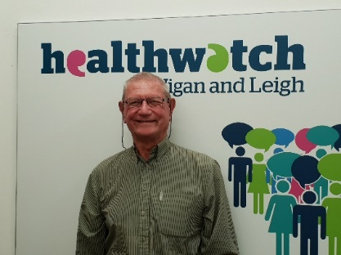
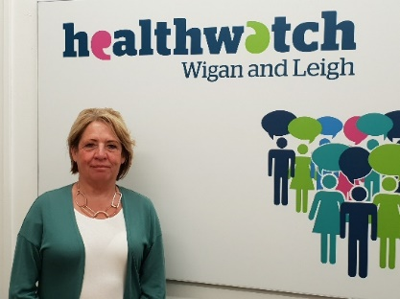
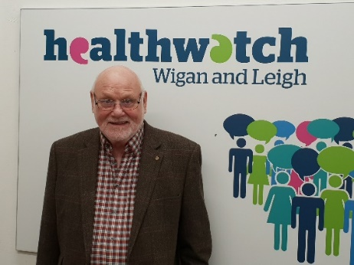
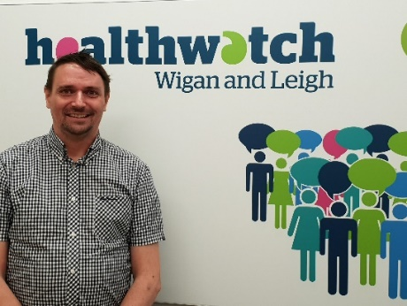
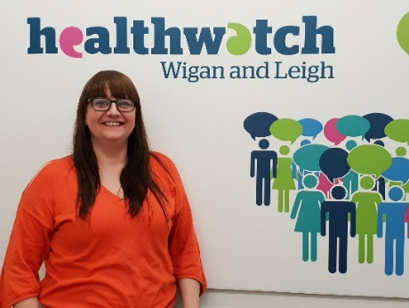
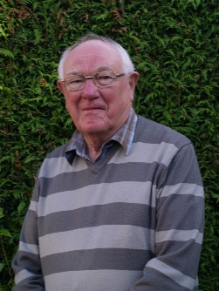
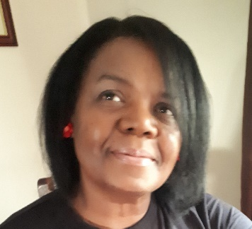
Healthwatch Wigan & Leigh - Our Directors
Chair : Mick Hodlin
Vice-Chair : Lynne Hamnett
David Porter
Dave Baxter
Wendy Boyers
William Greenwood OBE
Thelma Scott

Slide 2


About us…..

Slide 3
Background to Healthwatch
Healthwatch was created by Part 5 of the Health and Social Care Act 2012 (the Act) which paved the way for a national body, Healthwatch England (HWE), and a local organisation for each local council in England.
Healthwatch was introduced to help ensure that patients and the public are at the heart of health and social care services. Healthwatch Wigan and Leigh is part of a network of 152 local Healthwatch’s, supported at the national level by Healthwatch England.

Slide 4
What is Healthwatch
Independent consumer champion for health and social care across the country;
Gives a voice to patients, their carers and members of the public, influences positive change to services and help meet the health and social care needs of the population;
Healthwatch organisations must carry out a set of statutory functions and, importantly, each has a seat on its local health and wellbeing board;
Gather and collate people’s views and feedback about the health and care system;
Use this evidence to influence the commissioning, scrutiny and provision of services in their patch.

Slide 5
Healthwatch Wigan and Leigh
Statutory functions:
Promoting and supporting the involvement of local people in the commissioning, provision and scrutiny of local health and care services
Enabling local people to monitor the standard of provision of local care services and whether and how local care services could and ought to be improved
Obtaining the views of local people regarding their needs for, and experiences of, local health and care services and importantly to make these views known
Making reports and recommendations about how local care services could or ought to be improved. These should be directed to Commissioners and Providers of are services and people responsible for managing or scrutinising local care services and shared with Healthwatch England

Slide 6
Statutory functions continued…..
Providing advice and information about access to local care services so choices can be made
Formulating views on the standard of provision and whether and how the local care services could and ought to be improved; and sharing these views with Healthwatch England
Making recommendations to Healthwatch England to advise the Care Quality Commission to conduct special reviews or investigations (or where the circumstances justify doing so, making recommendations direct to the CQC); and to make recommendations to Healthwatch England to publish reports about issues
Providing Healthwatch England with the intelligence and insight it needs to enable it to perform effectively
To produce an annual report on our activities and finance

Slide 7
What is Enter and View
Enter and View is the opportunity for Authorised Representatives of Healthwatch Wigan and Leigh :
To go in to health and social care premises to hear and see how people experiences the services
To collect the views of service users (patients, clients, residents) at the point of delivery
To collect the views of carers and relatives of patients, clients or residents
To observe the service – observation involving all the senses
To collate evidence-based feedback
To report to Providers, CQC, Local Authority and NHS Commissioners and quality assurers, Healthwatch England and any other relevant partners

Slide 8
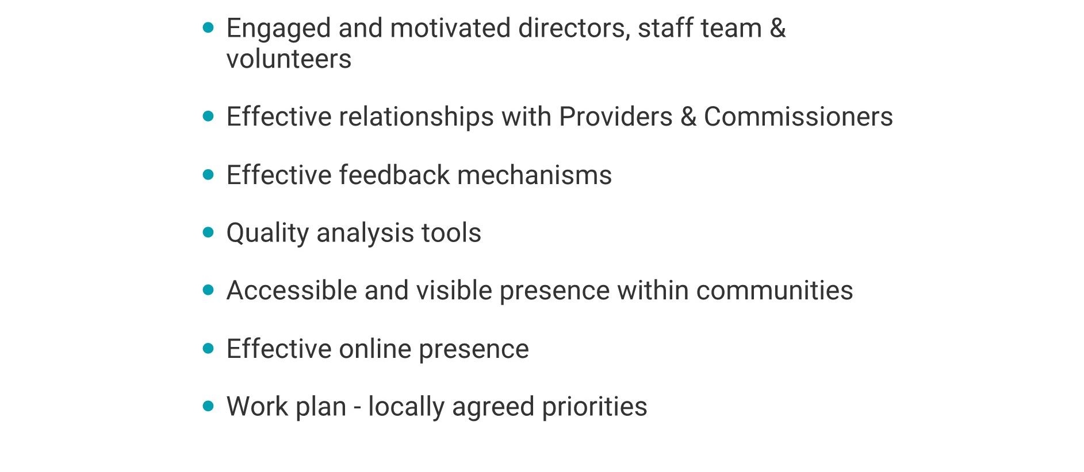
Healthwatch Wigan and Leigh
Key to our delivery:

Slide 9
Healthwatch Wigan & Leigh – Our Structure
Chief Officer
Healthwatch Board
Senior Engagement Officer
NHS Complaints Advocacy Officer
Audit Committee
Communication & Engagement Officer
Enter and View Sub-Committee
VOLUNTEERS!!

Slide 10
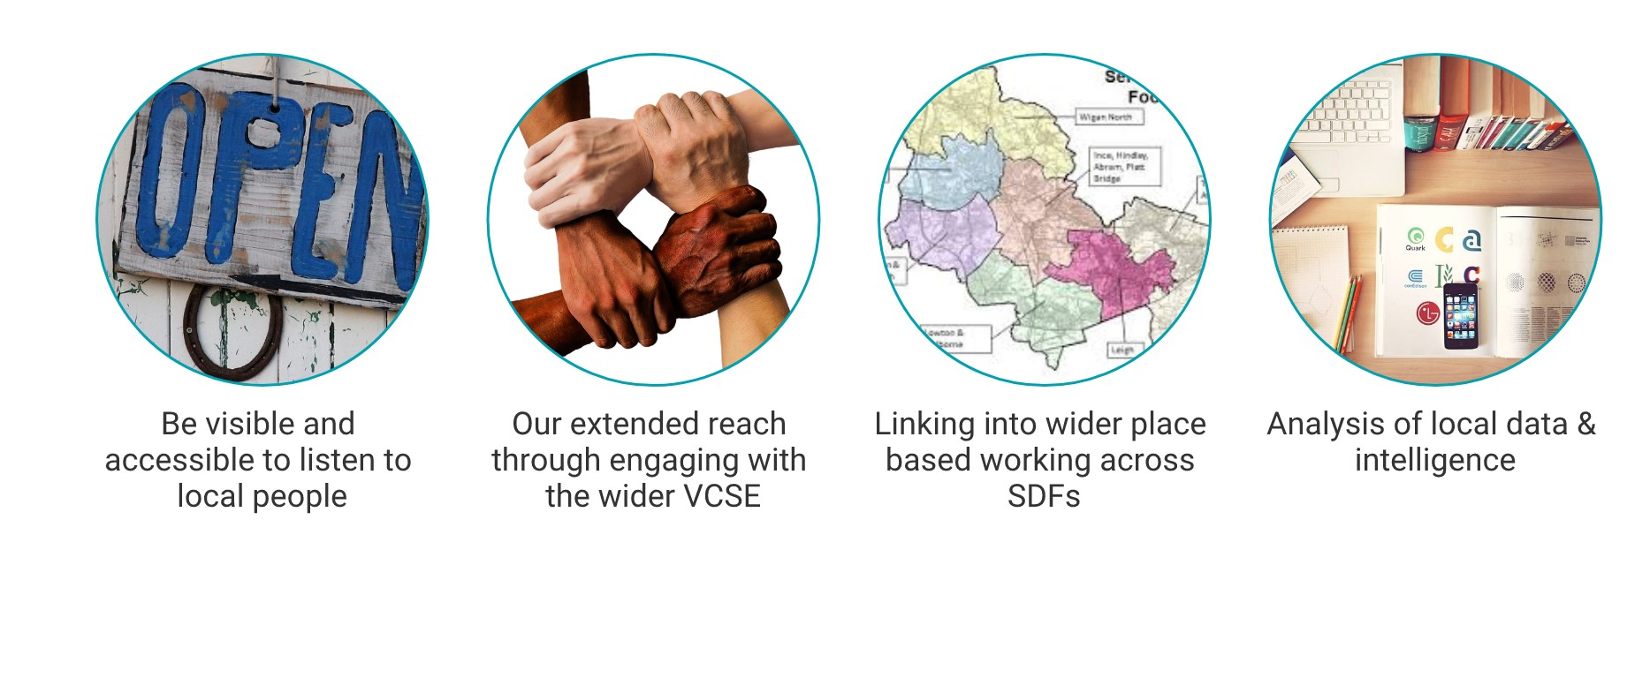
How we understand local needs

Slide 11
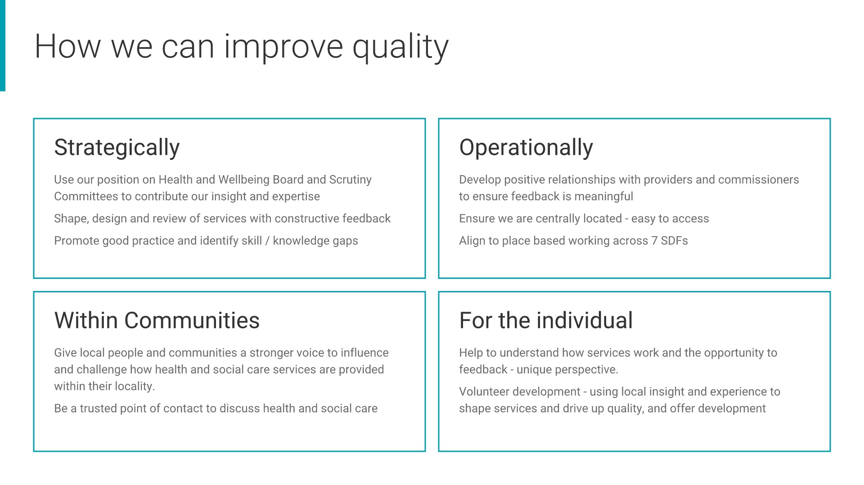
How we use information to understand local needs

Slide 12
Our ask……
Be aware of our role;
Signpost people to us that need information, advice, support or handholding with NHS complaints;
Invite us to your events;
Become a Healthwatch Champion – volunteer with us;
Follow us – Facebook, Twitter, Eventbrite etc…

Slide 13

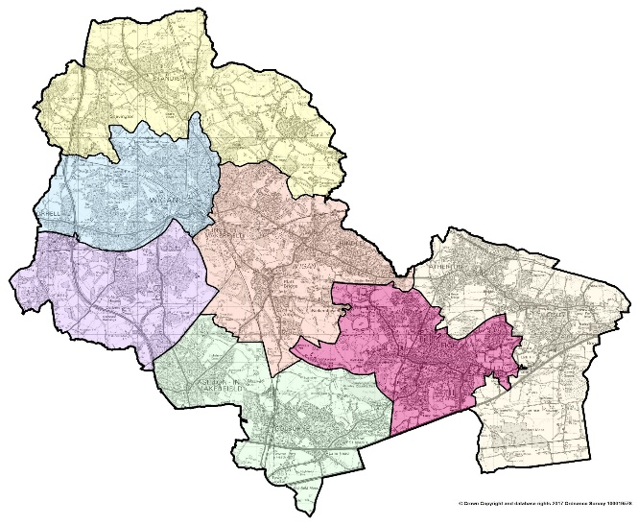


Volunteering opportunities
Project: Safeguarding and Access to GPs
Final dates for SWAN Engagement
Date | Time | Organisation | Location
27/02/2019 | 9:00am – 11:30am | Winstanley Medical Practice | Winstanley Medical Practice, Holmes House Avenue, Winstanley, Wigan WN3 6JN
06/03/2020 | 12:30pm – 3:00pm | Masjid Tooba Mosque | Clifton St, Worsley Mesnes, Wigan WN3 5HN
09/03/2020 | 10:00am – 12:00 noon | Greenslate Farm | Greenslate Rd, Billinge, Orrell, Wigan WN5 7BG
12/03/2020 | 9:30am – 12:00 noon | Medicenter | Medicentre, Ashton Health Centre, Council Avenue WN4 9AZ
11/03/2020 | 6:00pm – 8:00pm | Wigan Council community Networking Event | Worsley Mesnes Social Club Fairbrother Ave Off Poolstock Lane WN3 5HL
Safeguarding Project: Available for Enter and View Volunteers.
1
2
SWAN Engagement Figures
So far ..
Visited 6 locations
Spoken with 108 people
Completed 98 questionnaires
We still have more locations to visit
NEXT SDF LOCATION: ASHTON, LOWTON AND GOLBORNE.
WE NEED YOUR HELP!

Slide 14





Communication Update
Website Update – User centric approach
Volunteer Framework – Healthwatch England
Volunteer Training Programme
Volunteer Forum
Upcoming Digital Campaigns: World Autism Awareness Week, World Health Day, Stroke Awareness Month, Dementia Action Week
HWWL
@HealthwatchWL
@HWWiganLeigh

Slide 15
Current projects
Children’s Mental Health – who supports the parents?
Safely home? What happens when people leave hospital?
Circulating two surveys aimed at parents/carers & adults working with children and young people
Successful public event held 4th February attended by 76 people and gathering 114 comments and gathered great feedback
We continue to look for opportunities to hold focus groups around the Borough and welcome individuals or groups to contact us to arrange a session
Online survey to be distributed
To ensure engagement with people with additional vulnerabilities we will engage with VCSE groups and other organisations to complete paper versions of the survey
All data will be collected anonymously

Slide 16
Compliments and feedback
Can I say a massive thank you to Healthwatch Wigan and Leigh for this mornings presentations and asking 'who supports the parents’.
Thank you for today. I am now aware of the Willow project, something I had never heard of
I attended one of your Child Mental Health events last week and I wanted to commend you on the amazing work you are doing for YP in your area. Truly outstanding – I whole hearted believe prevention is better than cure, but to also know that there is help for parents of YP who are struggling, is brilliant!
Thank you so much for this event it is what I have needed, just to be able to talk to other people
I do feel better for coming. I totally relate to the speakers and am at the point that if I don't get support I will have to give up my job but this morning has really given me a space to think and come up with a pathway

Slide 17
Operational Updates
• Agreed KPI’s with Commissioner
• Implementing HWE Quality Framework
• Developed and implementing new database

Slide 18
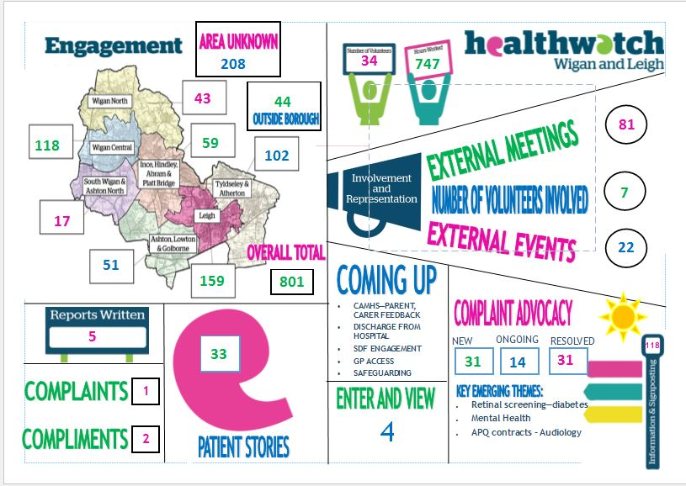
Report April – December 2019

Slide 19
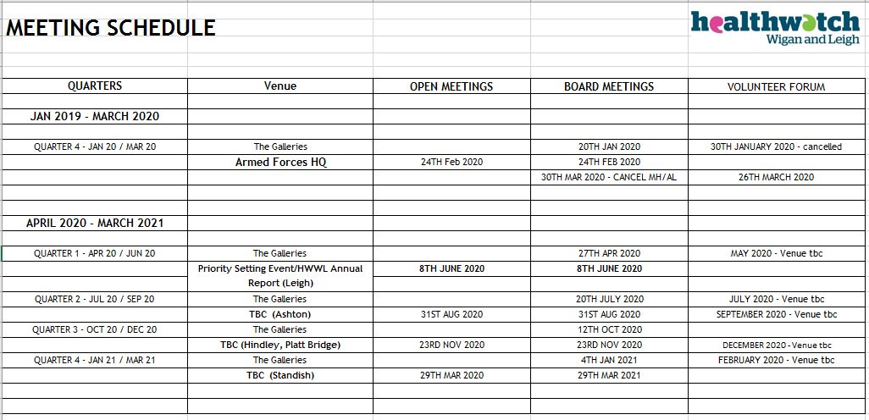
Meeting schedule

Slide 20
Any Questions?

